Slide 1
Mobile Programming - External Storage & Permissions
Sulaxan

Slide 2
Introduction to External Storage
External storage refers to the memory space on a mobile device that is accessible not only by the app that created the data but also by other apps, as well as the user.
It is typically used for storing data that doesn't require strong access restrictions and can include content like images, videos, documents, or any large files that may need to be shared across different apps.

Slide 3
Common Types of External Storage:
SD Cards: Physical storage cards that can be inserted into devices (common in Android but less prevalent in iOS).
Shared Internal Storage: A section of the internal memory that acts like external storage, allowing apps and users to access files stored in this space.
External storage is considered non-sensitive in nature because any other app or the user could potentially access and modify the data.

Slide 4
Public vs. Private External Storage
Public External Storage:
Definition: Public external storage is space on the device that any app can access, as well as the user. Files stored here are accessible system-wide.
Examples of Public Storage:
Music, videos, images saved by apps.
Documents and downloads.
Use Cases:
A photo-editing app may save images to public storage so that the gallery app can view them.
A media player can access music stored in public directories like Music or Downloads.

Slide 5
Characteristics:
Less Secure: Any app with the appropriate permissions can read/write to this storage.
Shared Among Apps: Data stored in public directories can be accessed by any app that has permission, making it ideal for files that users might want to share across multiple apps.
Drawbacks:
Security Issues: Data in public storage is more vulnerable to being modified or deleted by other apps.
Data Clutter: Public storage can become cluttered with files from multiple apps, making file management difficult.

Slide 6
Private External Storage:
Definition: Private external storage is app-specific space on the external storage medium. It remains in external memory but is sandboxed to the app that created it, preventing other apps from accessing or modifying it.
Examples of Private Storage:
A game storing downloadable content or additional resources.
A media app storing temporary media files like cache.
Use Cases:
Storing files such as app configurations, logs, and cached data that are necessary for the app’s functioning but not meant to be shared with other apps.

Slide 7
Characteristics:
More Secure: Although stored externally, this data is only accessible by the app that created it.
Temporary and App-Specific: Data stored in private directories can be wiped if the app is uninstalled or during system clean-up processes.
Drawbacks:
Still Vulnerable: While other apps can’t access these files, they are still stored externally, making them more vulnerable to manual deletion by the user or malfunction of external storage (e.g., SD card failure).

Slide 8
Internal vs. External Storage
Internal Storage:
Internal storage refers to the space within a mobile device where apps store sensitive data that is private to the app and cannot be accessed by other apps or the user unless the device is rooted or jailbroken.
Characteristics:
Secure: Files in internal storage are only accessible by the app that created them.
App-Specific: Each app has its own dedicated storage space.
Automatically Managed: The system will handle storage clean-up, and data is removed when the app is uninstalled.
Use Cases:
Sensitive Data: Credentials, databases, or configurations that should not be shared or modified by other apps.
Application Settings: Internal storage is suitable for storing small amounts of data that should be kept private and persistent (e.g., user preferences, app states).

Slide 9
External Storage:
External storage is a broader memory space available for apps to store data that doesn’t need strict privacy or is meant to be shared with other apps and users.
Characteristics:
Less Secure: External storage data can be accessed by any app that has the necessary permissions, and by users directly.
Used for Large Files: Since external storage typically has more capacity than internal storage, it is best suited for larger files such as videos, photos, and audio files.
Use Cases:
Media Files: Music, photos, videos that users may need access to outside of the app.
Documents and Downloads: Files that need to be shared across apps or downloaded for later use.

Slide 10
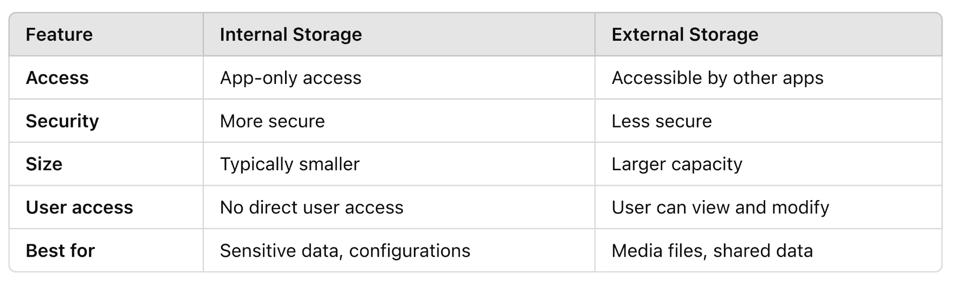
Feature

Slide 11
Importance of Permissions in Privacy and Security

Slide 12
1. Protecting User Data and Privacy
User Control: Permissions empower users to decide what data an app can access. Without a clear permission model, apps could access sensitive data without users' knowledge, leading to privacy breaches. Example: If an app requests access to a user’s contacts or location, the user can grant or deny this request. This prevents apps from automatically accessing this data without consent.
Transparency: Mobile OSes (Android and iOS) prompt users with detailed permission dialogs when apps request access to sensitive data. This provides transparency, as users can understand exactly what the app is asking to access.

Slide 13
2. Reducing Security Risks
Limiting Attack Surface: Permissions reduce the chance of a malicious app exploiting a device’s resources. By only granting permissions to trusted apps, users can prevent potential security breaches such as data theft, spying, or unauthorized use of system resources. Example: An app that requires access to the internet but has no legitimate reason to request access to the user’s contacts may be suspicious. With a strict permission model, users can deny unnecessary or suspicious requests.
Preventing Abuse: Without permissions, apps could abuse sensitive hardware or data, like continuously accessing the microphone or camera, without the user’s knowledge.

Slide 14
3. Controlling Resource Usage
Permissions also play a role in resource management, preventing apps from consuming device resources unnecessarily.
Battery Life: An app may request location access to track a user in real time. If location tracking is unnecessary, denying this permission can improve battery life by stopping the app from continuously accessing GPS.
Data Usage: Apps requesting background network access may consume significant amounts of data. With user control over permissions, such resource usage can be regulated.

Slide 15
4. Compliance with Regulations
GDPR and Other Privacy Laws: Permission models help app developers comply with global privacy regulations like GDPR (General Data Protection Regulation) and CCPA (California Consumer Privacy Act). These laws require apps to request explicit user consent before accessing personal data.
Example: Under GDPR, apps that collect user data (like email addresses or location) need to request clear consent and offer users the option to revoke permission later.

Slide 16
How Permissions Work in Mobile Development
Request Permission: When an app needs to access a sensitive component (e.g., camera, contacts), it asks for the user’s permission at runtime or during installation.
User Decision: The user is shown a dialog explaining why the app needs the permission and can either grant or deny access.
Handling Responses: The app must handle the user’s decision appropriately—continuing its operation or disabling features if access is denied.
Granting Permissions: If the user approves, the app can access the requested data or resource as needed.
Denying Permissions: If the user denies the permission, the app should gracefully handle the lack of access, either by disabling certain features or providing alternatives.

Slide 17
Mobile Permission Models
Android Permission Model:
Normal vs. Dangerous Permissions: Android distinguishes between permissions that are deemed less risky (normal) and those that could pose a threat to user privacy or security (dangerous).
Normal Permissions: Automatically granted without user intervention (e.g., internet access).
Dangerous Permissions: Must be requested at runtime (e.g., access to location, storage, contacts).
Runtime Permissions (Android 6.0 and Above): Apps must request dangerous permissions at runtime instead of when the app is installed. This ensures that permissions are requested when they are actually needed. Example: A photo-editing app only requests camera access when the user attempts to take a picture.

Slide 18
iOS Permission Model:
App Sandbox: iOS apps are sandboxed, meaning they can only access their own data and need explicit permissions to access system data or resources (e.g., camera, location, contacts).
Fine-Grained Control: iOS allows users to modify permissions after granting them. Users can visit the app settings to turn permissions on or off for each individual app. Example: If a user grants location access to a navigation app, they can later revoke this access in the system settings without uninstalling the app.

Slide 19
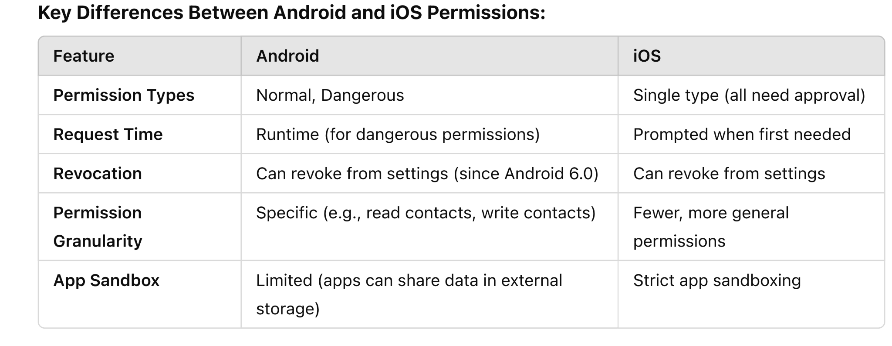

Slide 20
Android Permission Model

Slide 21
1. Runtime Permissions (Introduced in Android 6.0)
Before Android 6.0, permissions were granted at install time, meaning users had to agree to all requested permissions before even using the app. This led to privacy concerns, as users couldn’t choose which permissions to allow or deny once the app was installed.
Starting with Android 6.0, a new runtime permissions model was introduced:
Apps no longer get all permissions at install time.
Instead, permissions are requested when the app actually needs them.
This makes it easier for users to understand why certain permissions are being requested and only grant access when necessary.

Slide 22
2. Normal vs. Dangerous Permissions
Android classifies permissions into two main types:
Normal Permissions:
Permissions that pose little to no risk to the user’s privacy or security.
These are automatically granted by the system when the app is installed, and the user is not prompted to approve them.
Examples:
Accessing the internet (INTERNET).
Setting an alarm (SET_ALARM).

Slide 23
Dangerous Permissions:
Permissions that allow access to sensitive data or functions that could impact the user’s privacy or security.
These permissions require explicit approval from the user at runtime, and the app must request them dynamically.
Examples:
Accessing the user’s location (ACCESS_FINE_LOCATION).
Reading and writing to external storage (READ_EXTERNAL_STORAGE, WRITE_EXTERNAL_STORAGE).

Slide 24
How Dangerous Permissions Work:
The app checks whether it has the necessary permission.
If not, it triggers a permission request prompt.
The user can grant or deny the request.
The app must handle both outcomes (grant or denial) appropriately.

Slide 25
Storage-Related Permissions
1. READ_EXTERNAL_STORAGE Permission
Purpose: This permission allows an app to read from external storage, such as media files (photos, videos, and documents) that the user has saved.
Use Case: A photo-editing app needs to access the user’s photo gallery to load images for editing.
2. WRITE_EXTERNAL_STORAGE Permission
Purpose: This permission allows an app to write data to external storage. It includes the ability to create, modify, and delete files within external storage.
Use Case: A document editor needs to save edited files to the user’s Downloads folder or a custom folder in external storage.

Slide 26
Scoped Storage (Introduced in Android 10)
Key Changes with Scoped Storage:
App-Specific Storage:
Each app can only access files it created in its own app-specific directory.
Apps no longer need the WRITE_EXTERNAL_STORAGE permission to write to their app-specific directories.
Limited Access to Shared Storage:
Apps can no longer directly access files in shared storage unless they use a dedicated MediaStore API or request permission from the user.
This means apps can read and modify only their own files and specific user-approved files (e.g., photos, videos).
No More Global Write Permissions:
Apps that target Android 10 and above no longer need WRITE_EXTERNAL_STORAGE for most write operations.
Scoped Storage restricts access to external storage, forcing apps to use only their specific directories unless they explicitly request broad access.

Slide 27
Scoped Storage and Privacy:
By limiting access to shared files, Scoped Storage ensures that apps cannot manipulate or delete files from other apps or access sensitive data stored in external storage.
Exceptions: Apps like file managers can request the special MANAGE_EXTERNAL_STORAGE permission to gain broader access to external storage (introduced in Android 11).
Impacts of Scoped Storage:
More Secure: Scoped Storage improves security by limiting the exposure of sensitive user data.
Backwards Compatibility: For apps targeting Android 9 (Pie) and below, the traditional external storage permissions model (using READ_EXTERNAL_STORAGE and WRITE_EXTERNAL_STORAGE) still applies.
User Control: Scoped Storage gives users more control over which files apps can access, reducing the risk of accidental data exposure.

Slide 28
Best Practices for Requesting Storage Permissions
Request Permissions Only When Needed:
Don’t ask for permissions at the start of the app. Instead, request them when the user performs an action that requires the permission (e.g., saving a file).
Explain Why Permissions Are Needed:
Always explain to the user why you are requesting a specific permission. This can be done via the permission dialog or by showing an in-app explanation before requesting.
Handle Denied Permissions Gracefully:
If the user denies a permission, offer an alternative or disable the related functionality without breaking the entire app experience.
Respect Scoped Storage:
For apps targeting Android 10 and above, use Scoped Storage for accessing external files, and avoid requesting broad storage permissions unless absolutely necessary.

